Slide 1
Introduction to Big Data
Python-1

Slide 2
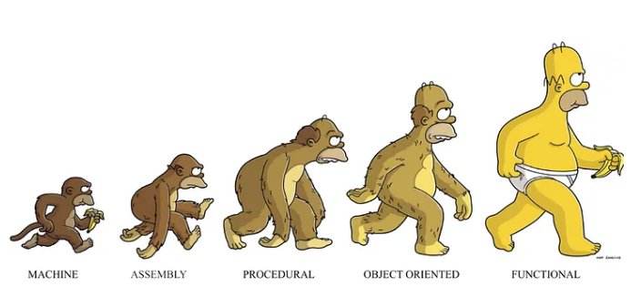
Python
• Very popular general-purpose programming language
• Used from introductory programming courses to production systems
• Software programmer Guido van Rossum from Netherlands in 1990
• Name is given from a show called Flying Circus by English comedy group Monty Python
Python supports:
• Structural programming
• Object oriented programming
• Functional programming

Slide 3
Python Programming
• Many IDEs available or
• Notepad + Python interpreter or
• Anaconda which has Spyder and Jupyter Notebook software for Python programming
• Two versions of Python in use - Python 2 and Python 3
• Python 3 not backward-compatible with Python 2
• A lot of packages are available for Python 2
• Check version using the following command
$ python -- version

Slide 4
Python Features
Python programs are comparatively…
+ Quicker to write
+ Shorter
+ Ease of programming
+ Minimizes the time to develop and maintain code
+ Modular and object-oriented
+ Large community of users
+ A large standard and user-contributed library

Slide 5
Python for Data Analytics
• Fairly easy to read/write/process data using standard features
• Plus special packages for…
• Numerical and statistical manipulations - numpy
• Visualization (“plotting”) - matplotlib
• Relational database like capabilities – pandas
• Machine learning - scikit-learn
• Network analysis - networkx
• Unstructured data – re, nltk, PIL

Slide 6
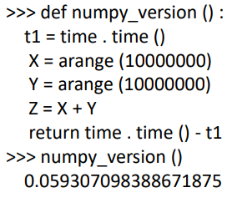
More on Python
• Numpy api
Simple but not limited. Numpy: the main API used for what is called “scientific computing ecosystem.” Numpy handles linear algebra and matrix mathematics on a very large scale. Most machine learning algorithms and neural networks operate on these n-dimensional matrices.
• Apache Spark has a Python shell.
You can open datasets, do transformations, and run algorithms in one easy command line. Without that you would have to package your program and then submit it to Spark using spark-submit. The disadvantage with spark-submit, as with any batch job, is you cannot inspect variables in real time. So can print values to a log. That’s OK for text, but when you use the Python shell that text is an object, which means you can further work with it. It’s not a static non-entity.

Slide 7
Anaconda Installation Instruction
https://www.anaconda.com/download
You can download the anaconda installation files suitable for your operating system from the link above.
Python course will be carried out through the jupyter notebook program.

Slide 8
Python Anaconda
Python Anaconda is an integrated python distribution system for developers who want to develop various similar scientific applications such as data science, analytics, and machine learning using Python.
In addition to containing packages, environment managers and more than 1500 open source packages for scientific applications such as artificial intelligence, data science and analysis, it also includes developer interfaces such as "Spyder" and "Jupyter Notebook".

Slide 9
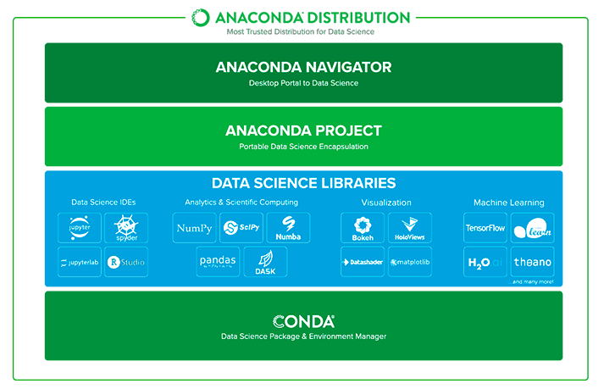

Slide 10
Why Should We Use Anaconda?
It is a free, open source structure with detailed help documentation that serves a wide community.
It has a structure that eliminates package dependency and version control problems in projects.
Jupyter allows us to create data science projects using various IDEs such as JupyterLab, Spyder, and RStudio.
While creating our project files, we can easily install the Python version we want with the features we want. When using Python pip packages, it takes into account compatibility with other packages, eliminating errors that may occur in installing the correct packages.

Slide 11
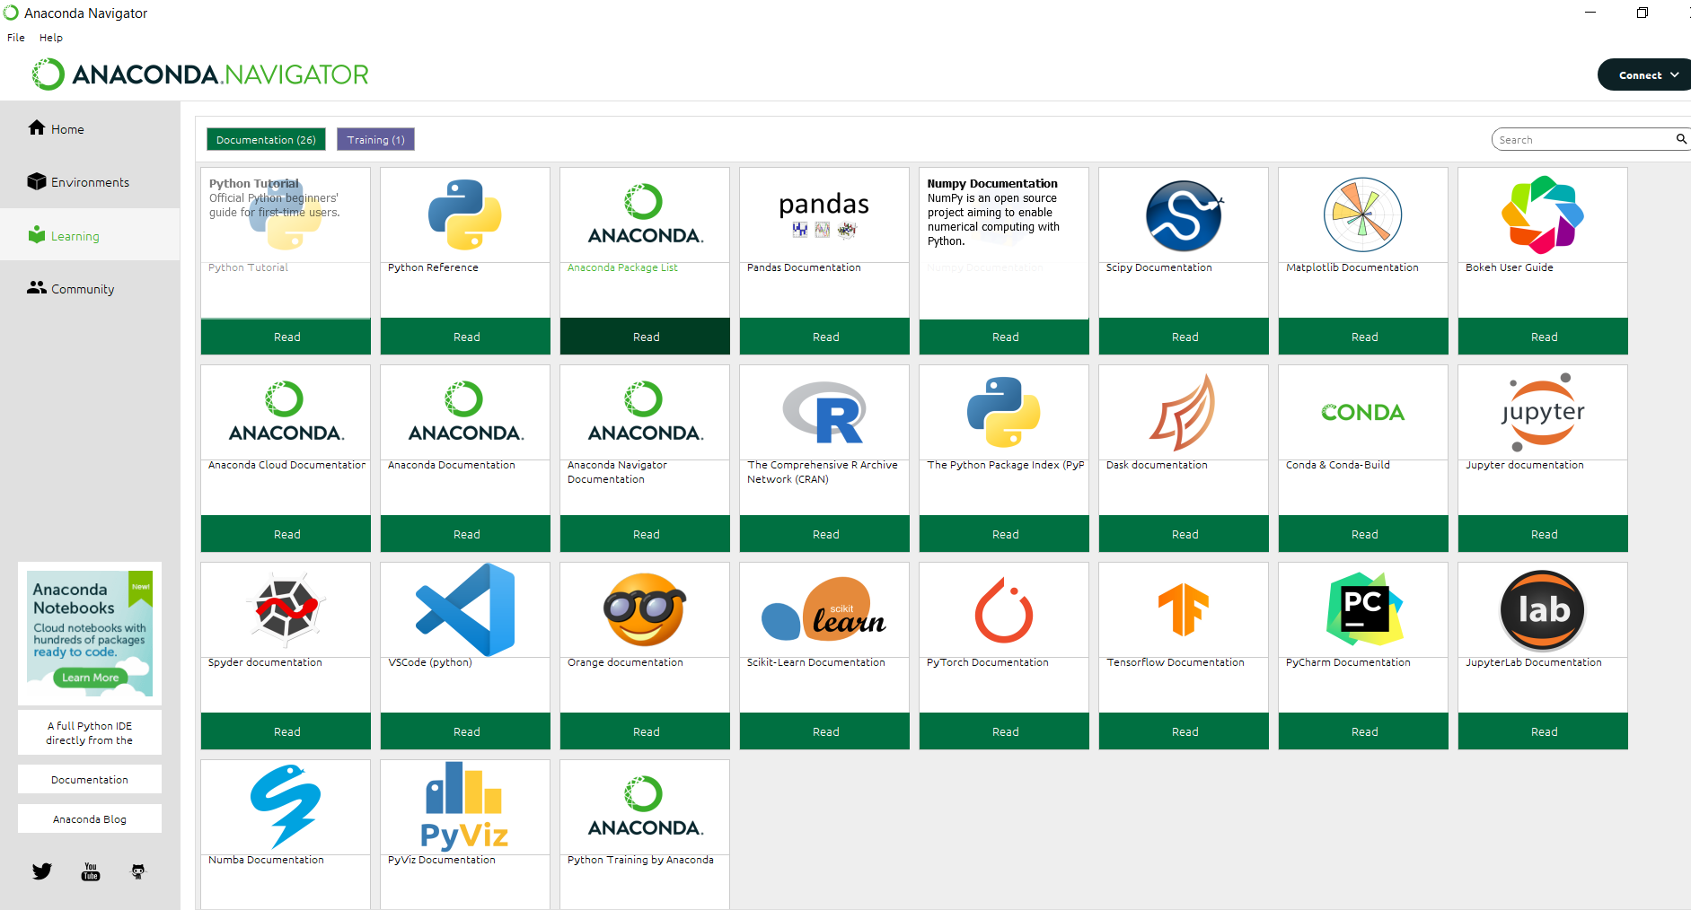

Slide 12
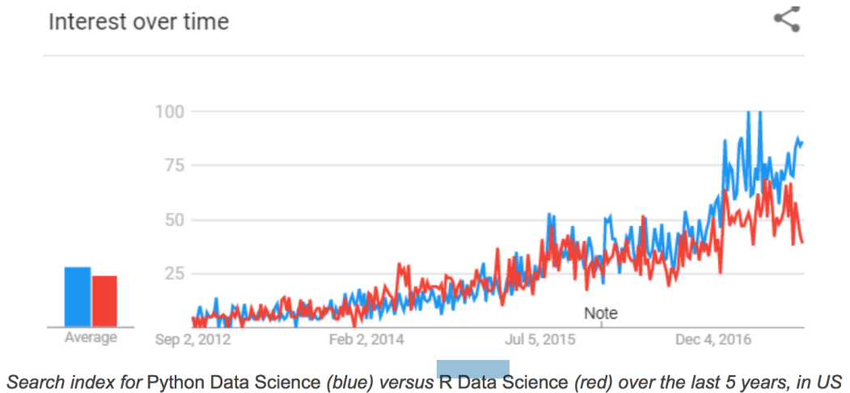
Python-R

Slide 13
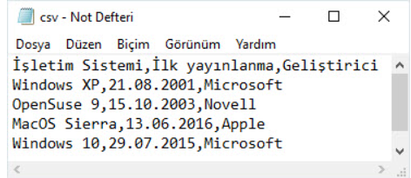
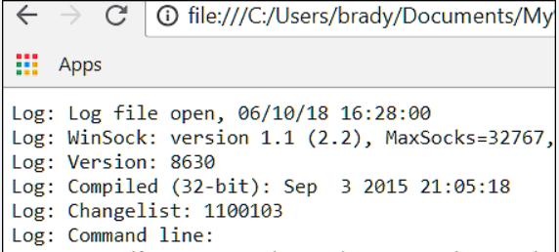
Numpy (Numerical Python)= It is one of the Python language libraries that allows us to work with multidimensional arrays and matrices and perform mathematical operations.
Pandas=It is a software library written in the Python programming language for data processing and analysis.
Matplotlib= The most popular library used for visualization
Scikit-learn= The library with the most active use in the use of machine learning algorithms.

Slide 14
Python 2.x –Python 3.x – IDE (Integrated Development Environments)
Python 3.11
IDEs
PyCharm
Spyder
Python Tools for Visual Studio
Komodo IDE
Jupyter Notebook

Slide 15
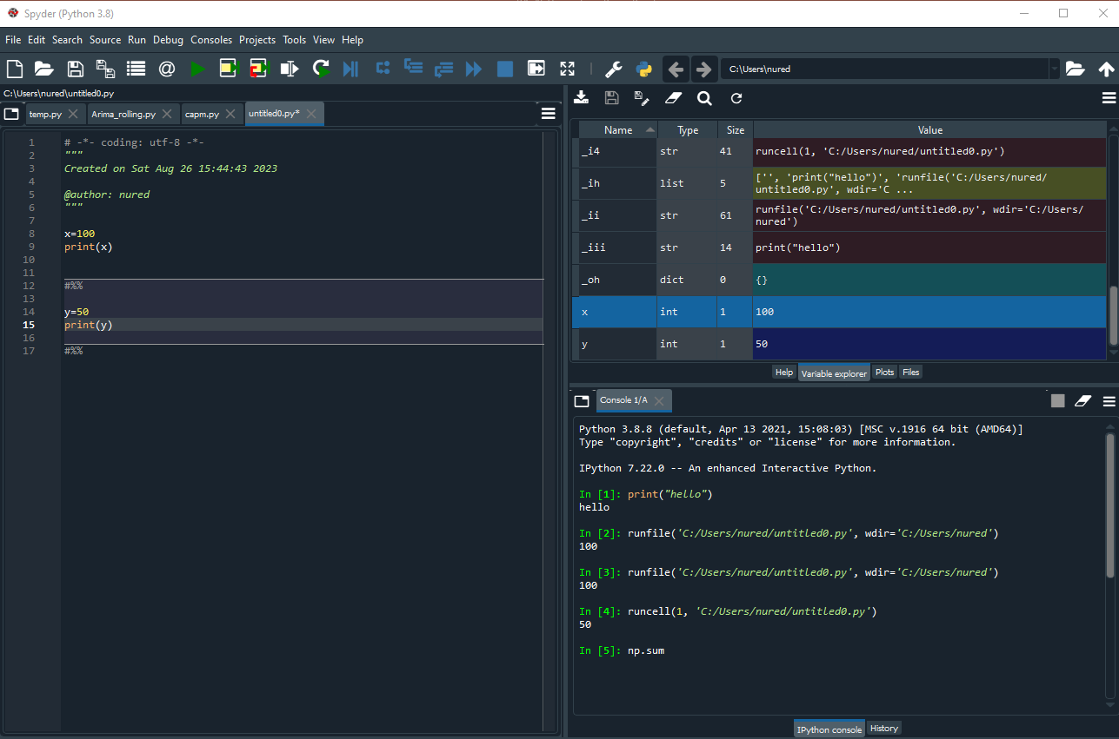
Spyder

Slide 16
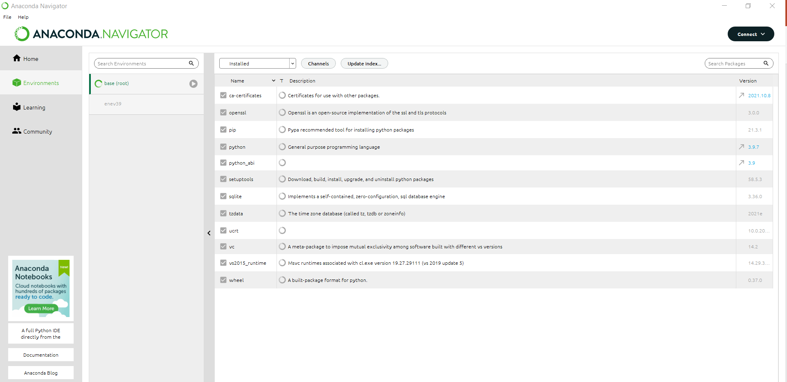
Paket Yöneticisi

Slide 17
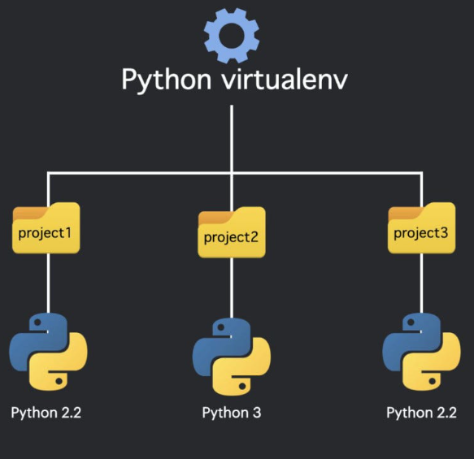
Virtual Environment
The virtual environment is useful for managing packages in different projects. Using a virtual environment eliminates problems that may arise after installing packages globally.

